Slide 1
Neural Architectures:
Transformers
Introduction to Deep Learning: Class 5.7

Slide 2
Agenda
Recap transformer architecture
Decoding techniques
KV-caching

Slide 3
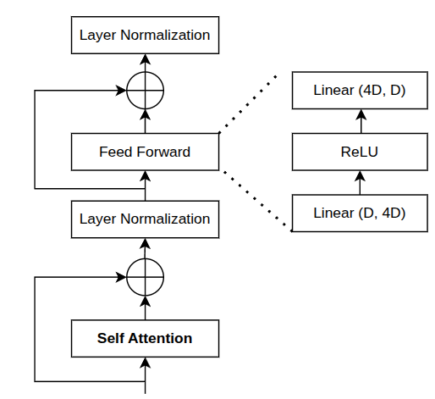
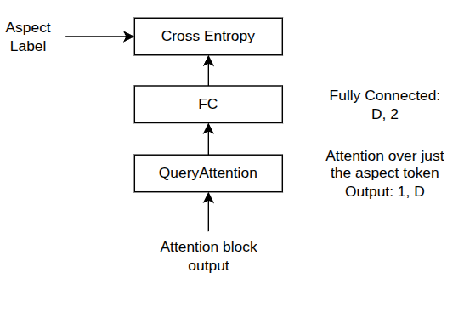
Quick Recap: Transformer Architecture
Attention Block
Outputs contextualized embeddings
Feed Forward: Mixes info across embedding (channel) dimension with non-linearities
Skip Connection: Stable optimization, don’t destroy previous representation
LayerNorm: Keeps activations well-scaled, learning stable
1, T, D
e1+p1 | e2+p2 | e3+p3 | e4+p4 | e5+p5 | e6+p6 | e7+p7 | e8+p8 | e_pad+p9 | e_pad+p10 | e_pad+p11 | e_pad+p12
Trainable token + position embeddings
1 | 1 | 1 | 1 | 1 | 1 | 1 | 1 | 0 | 0 | 0 | 0
Attention mask
t1 | t2 | t3 | t4 | t5 | t6 | t7 | t8 | pad | pad | pad | pad
Tokenization
Input Sentence

Slide 4
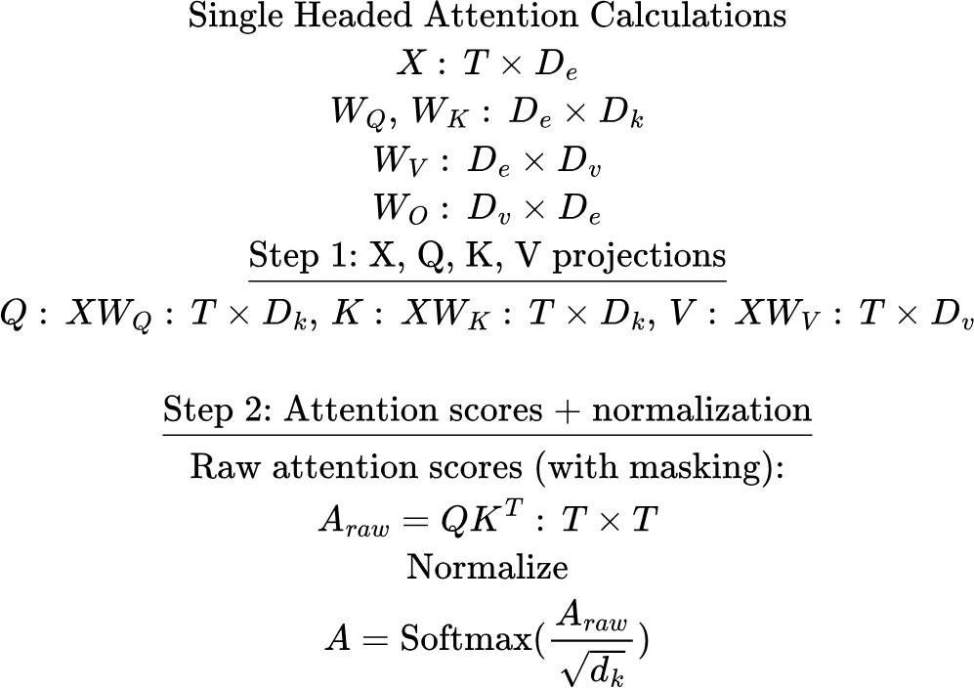
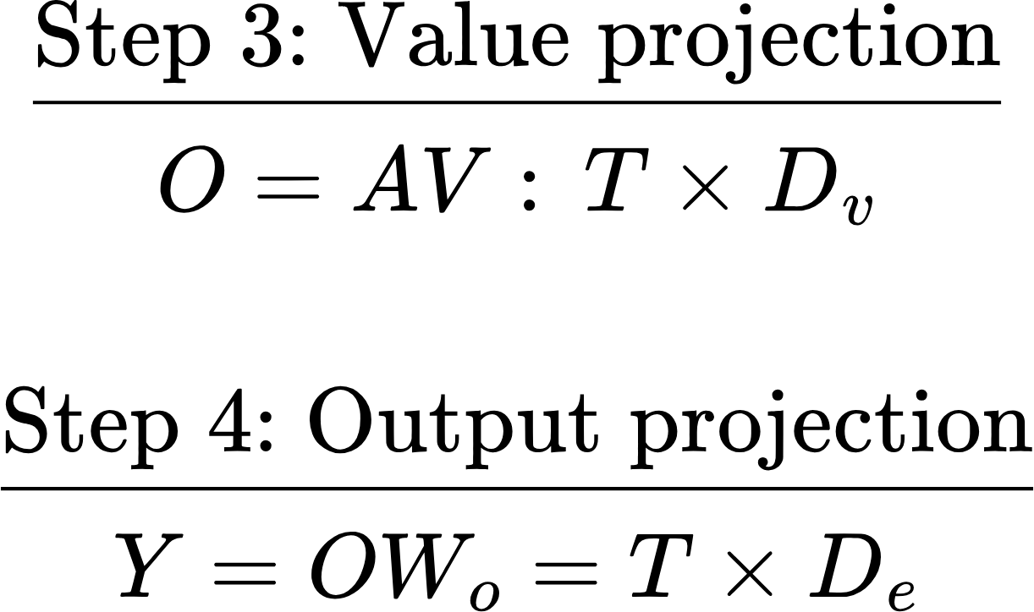
Attention Summary

Slide 5
Decoder-only (Generative) models
Key idea: The model needs to learn to assign higher probabilities to more plausible input sequences
P(model, needs, to, learn) > P(needs, learns, model, to)
Like BERT, the training signal is inherent in the token sequence. How do we utilize this in a generative context?
To do this, each token must only see the tokens before it.. This is implemented using a causal attention mask

Slide 6
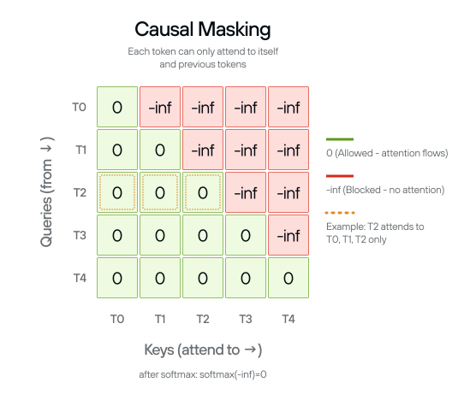
Causal Attention Mask
T0 only sees the keys corresponding to T0
T1 only sees the keys corresponding to T0, T1
T2 only sees the keys corresponding to T0, T1, T2

Slide 7
Generative Model: Training
X-entropy loss
Target tokens
Hello, how, are, you, <EOS>
Predicting end of a sentence is very important!
<BOS>, Hello, how, are, you
Target logits
Input
Target
Transformer Block
Causal Attention Mask
<BOS>, Hello, how, are, you
Hello, how, are, you, <EOS>
<BOS>, Hello, how, are, you, <EOS>
Input tokens
Tokenization, embedding lookup, positional embeddings remain unchanged
Hello, how, are, you

Slide 8
Generative Model: Training
We are computing in parallel
P(Hello|Bos)
P(How|Bos, Hello)
P(Are|Bos, Hello, How)
P(You|Bos, Hello, How, Are)
P(EOS|Bos, Hello, How, Are, You)
And minimizing the negative of the sum of these probabilities
Training Signal:
weak / diffuse for short ambiguous prefixes
stronger / sharper for longer informative prefixes

Slide 9
Generative Model: Inference
Key idea: Autoregressively generate one token after the other
fox
jumps
over
Decoding: Sample a token
Decoding
Decoding
Probability distribution over tokens: p(V)
p(V)
p(V)
Transformer
Transformer
Transformer
<BOS>, The, quick, brown
<BOS>, The, quick, brown, fox
<BOS>, The, quick, brown, fox, jumps

Slide 10
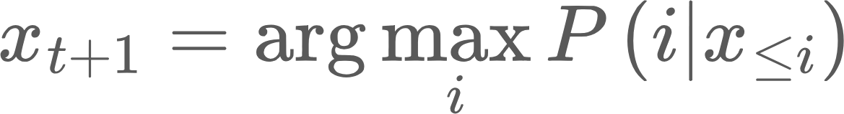
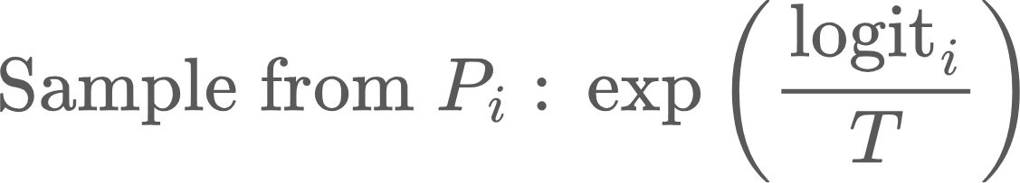
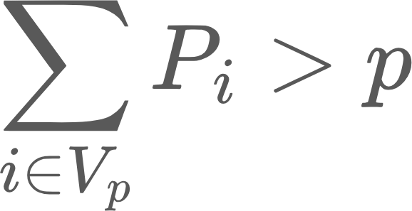
Decoding techniques
Greedy decoding: Pick most probably token
Deterministic
Temperature sampling
Allows some degree of randomness
Adjusted by T. T> 1: more randomness and vice versa
Top-k sampling
Keep the top K tokens by probability, renormalize and sample
Only keep the most plausible tokens
Top-P nucleus sampling
Keep smallest set of tokens whose cumulative probability > p
Intuition: keep enough tokens to cover most of the probability mass
Repetition penalty:
Beam Search

Slide 11
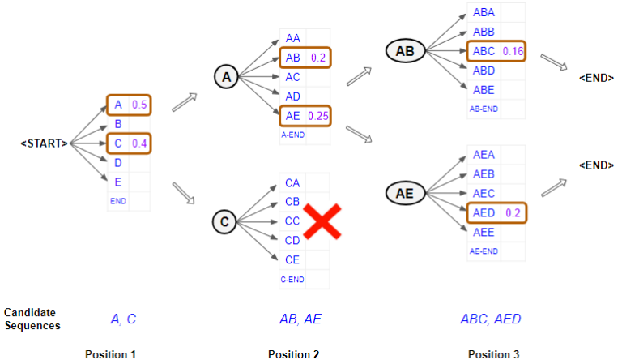
Beam Search
Problem with Greedy decoding techniques is that once you pick a suboptimal token, you are stuck with it, as all future tokens are conditioned on it.
Beam search:
Keep B tokens at each generation step
Run B parallel generations and sample B best tokens from BV possibilities
Track which beam each token came from
Stop after predefined number of steps, or after most (say k) beams produce EOS
Trace back to pick the most likely completion, by summing log probs
Pros: Can lead to more diverse outcomes
Cons: Computationally much more expensive
Less commonly used now

Slide 12
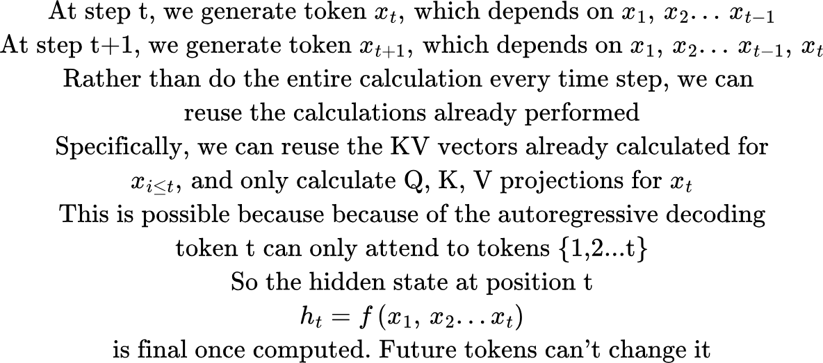
KV Caching

Slide 13
Issues with kv-caching
Size of the cache: [seq len, num layers, num heads, head dimension]
As decoding proceeds, sequence length grows token by token, KV cache memory grows linearly, and is needed for the entire request
Now consider a real system
Many requests
Each with different prefix lengths
Each with different number of generated tokens.. We don’t know apriory when generation would end

Slide 14
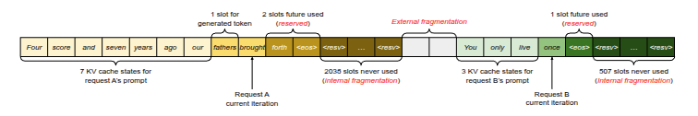
Fragmentation problem
You allocate one big block per sequence
Request A: 2048 tokens
Request B: 512 tokens
Request C: 4096 tokens..
If I reserve a block of 4K tokens, that wastes memory for A and B, but not enough for C. I’ll have to reallocate another bigger block, and copy the KV cache in the middle of decode!

Slide 15
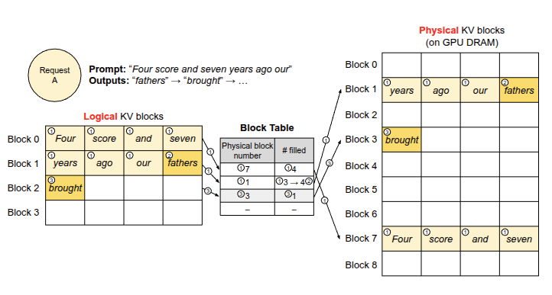
Paged attention
Key idea: Instead of each sequence owning its own contiguous memory block, it maintains a logical view of several small physical blocks

Slide 16
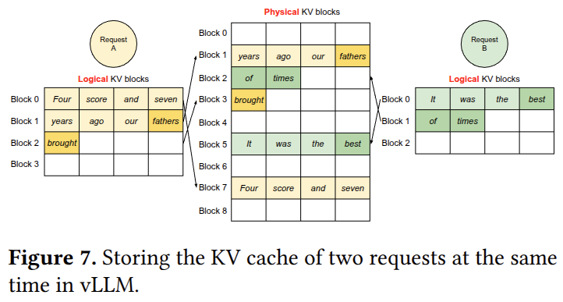
Paged attention
No need to guess seq len. Just allocate pages on-demand. When completion finishes, release pages back to the pool

Slide 17
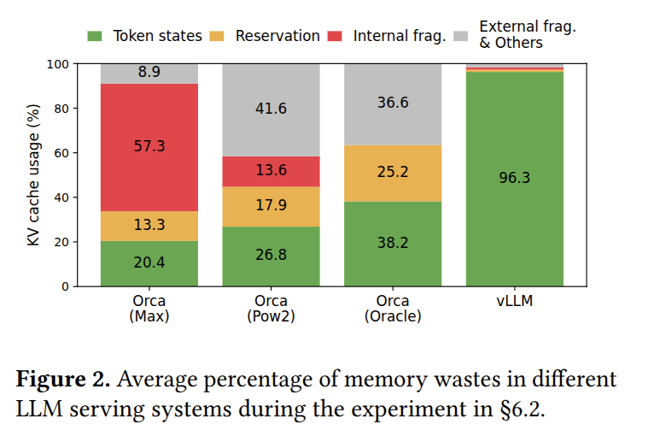
Paged Attention: Memory Savings

